Slide 1
EE 205, Yung Yi Lecture 2: Array and Linked Lists

Slide 2
Overview and Reading
Reading: Chapters: 3.1, 3.2, and 3.3
Basic Elementary Data Structures
Array
Linked Lists
Singly linked lists
Doubly linked lists
Circular linked lists
These are used for more advanced data structures later

Slide 3
Array (§ 3.1)
Memory
a
b
c
d
start
Storing data in a sequential memory locations
Access each element using integer index
Very basic, popular, and simple
int a[10]; int *a = new int(10);

Slide 4
Array: Problems
New insertion and deletion: difficult
Need to shift to make space for insertion
Need to fill empty positions after deletion
Why don’t we connect all elements just “logically” not “physically”?
Linked List

Slide 5
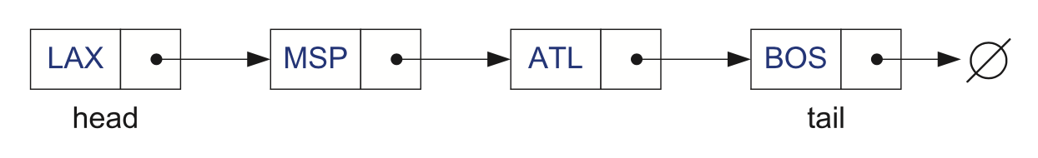
Singly Linked List (§ 3.2)
A singly linked list is a concrete data structure consisting of a sequence of nodes
Each node stores
element
link to the next node
next
elem
node

Slide 6
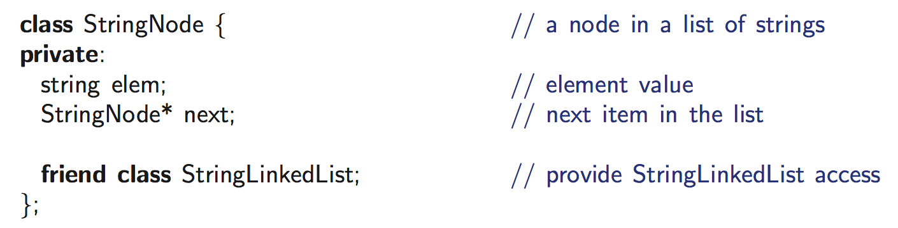
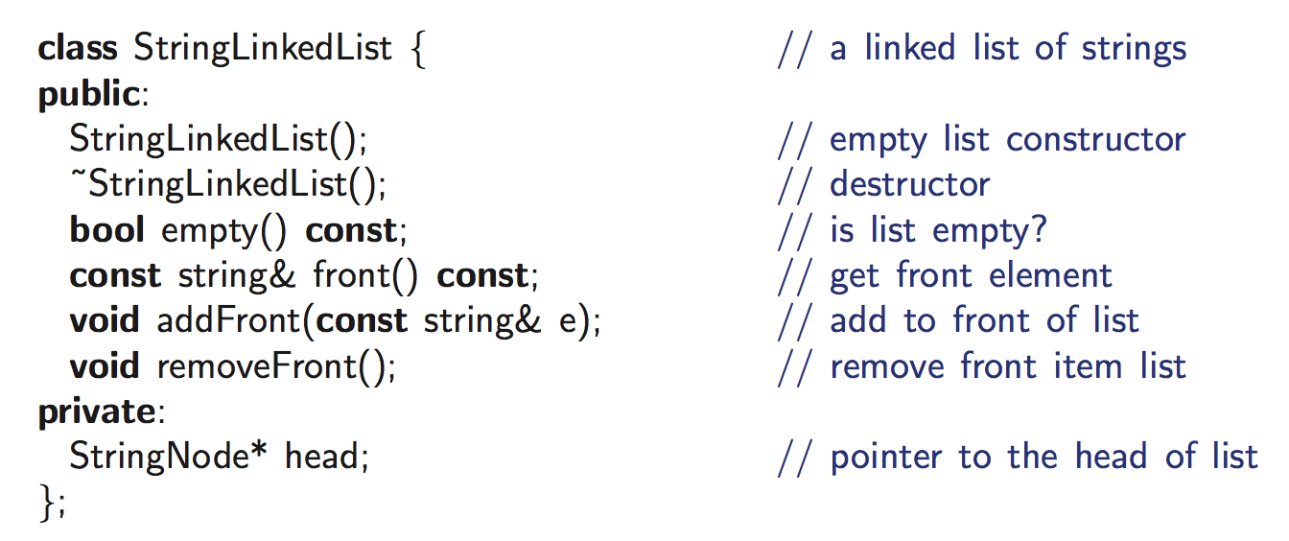
Example: Linked list of strings

Slide 7
Singly Linked List of Strings: Picture
StringLinkedList
*head
StringNode
StringNode
StringNode
StringNode
StringNode
next
next
next
next
NULL
“yy”
“bb”
“cc”
“dd”
“ee”

Slide 8
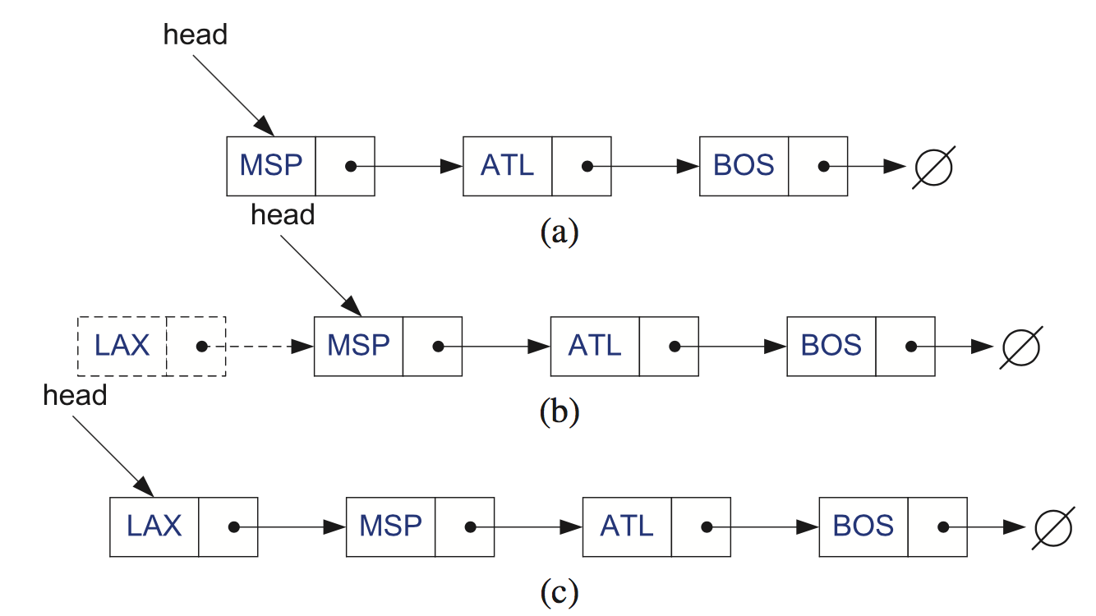
Inserting at the Head
Allocate a new node
Insert a new element
Have the new node point to the old head
Update head to point to new node

Slide 9
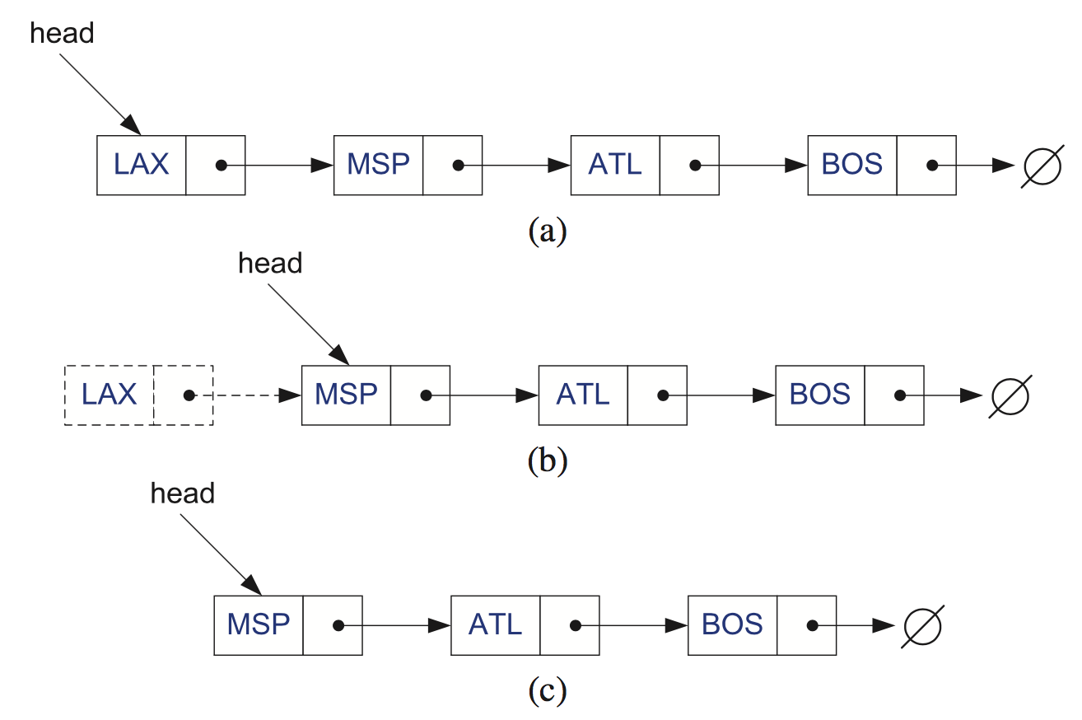
Removing at the Head
Update head to point to next node in the list
Allow garbage collector to reclaim the former first node
(typically done by calling “delete” in C++)

Slide 10
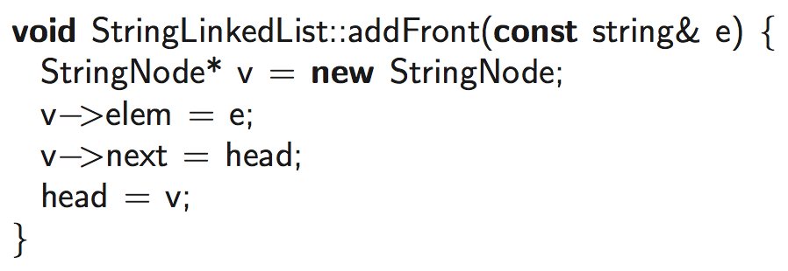
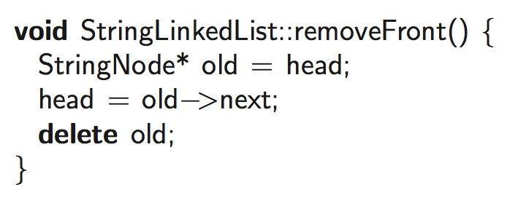
Let’s make codes

Slide 11
Inserting at the Tail and Removing at the Tail
Allocate a new node
Insert new element
Have new node point to null
Have old last node point to new node
Update tail to point to new node
Insertion at the tail
…
...
…
…
Removal at the tail

Slide 12
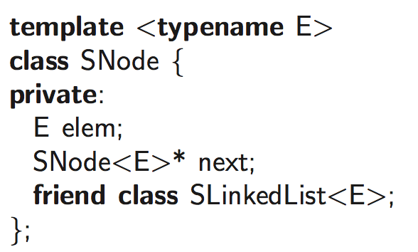
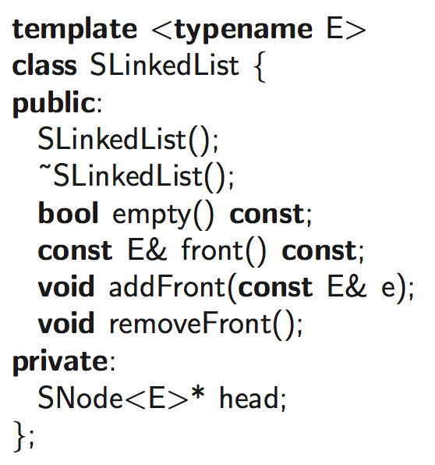
”Generic” Singly Linked Lists: Template
See the implementation code of member functions
in the text (page 122)

Slide 13
Doubly Linked List (§ 3.3)
Singly Linked List
Not easy to remove an elem. at the tail (or any other node)
Trailer: Dummy sentinel
Previous link
prev
next
elem
node
header
nodes
trailer
elements

Slide 14
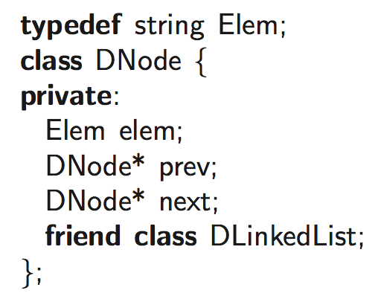
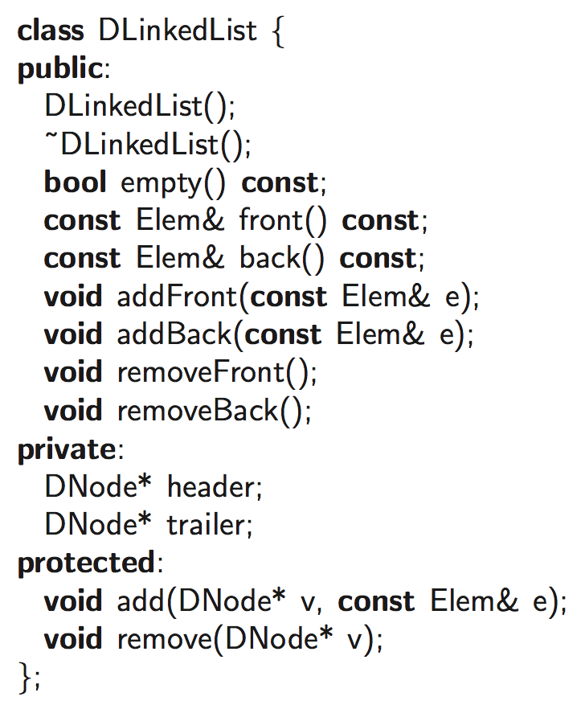
C++ Implementation: Class Design

Slide 15
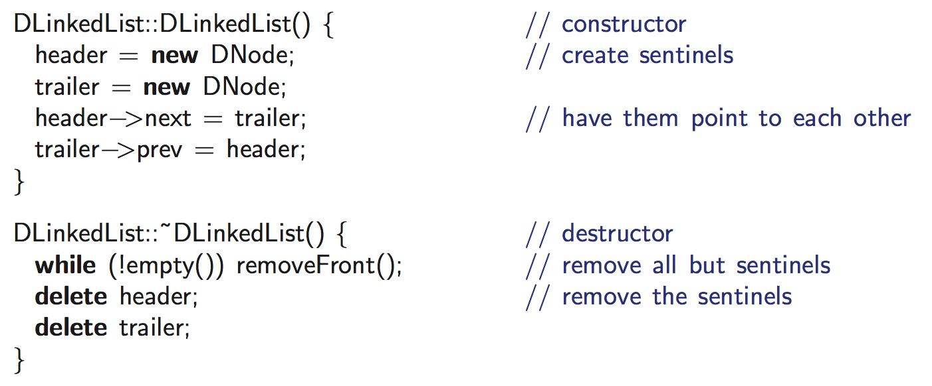
Constructor and Destructor (Don’t forget!)

Slide 16
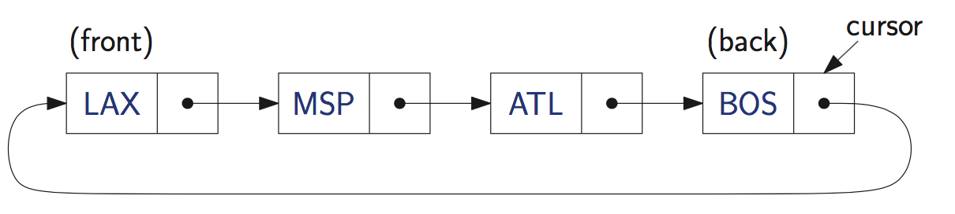
Circular Linked List (§ 3.3)
A kind of Singly Linked List
Rather than having a head or a tail, it forms a cycle
Cursor
A virtual starting node
This can be varying as we perform operations

Slide 17
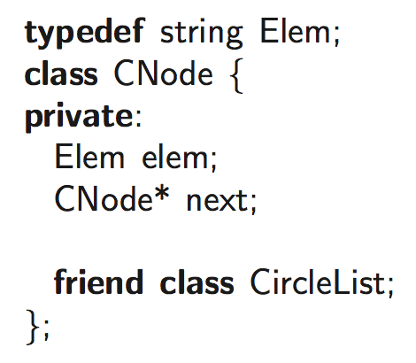
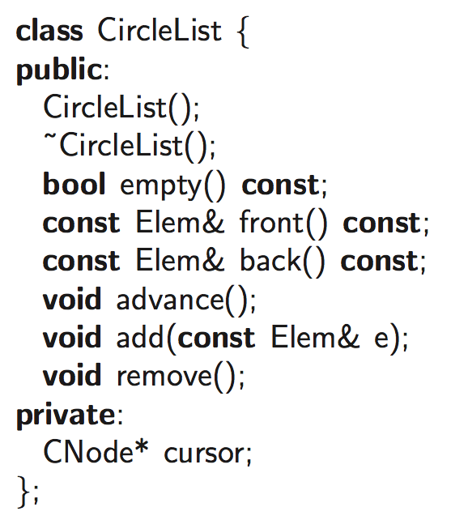
C++ Implementation
What is advance()?

Slide 18
Summary
Array and Lists
A simple data structure to store multiple elements (of the same type)
Array
Singly Linked Lists
Doubly Linked Lists
Circular Linked Lists
Key Question
For each of the operations, how efficiently does each data structure perform the operation?

